Slide 1
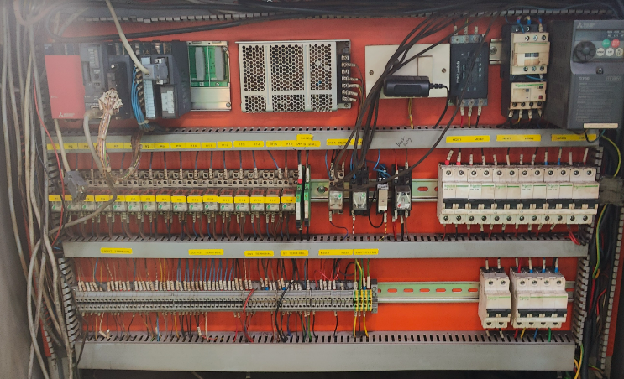
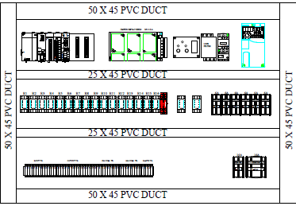
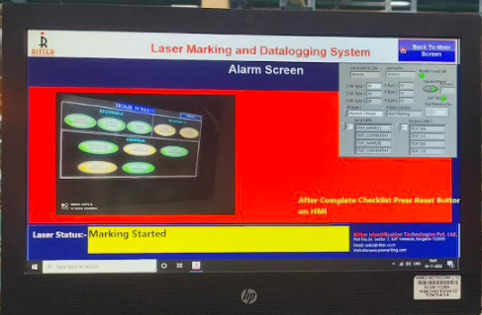
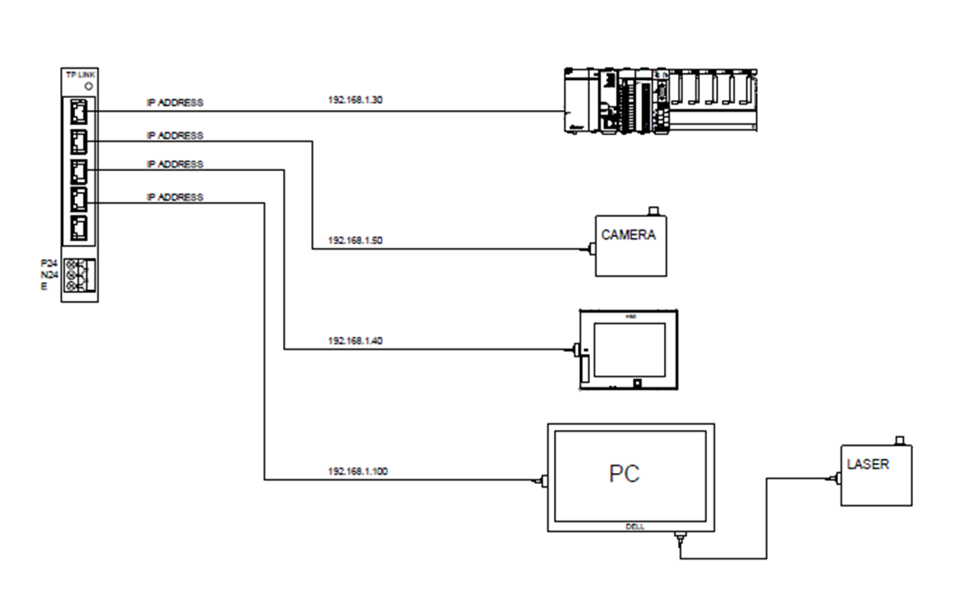
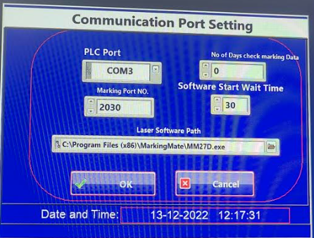



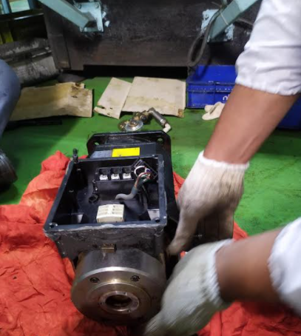
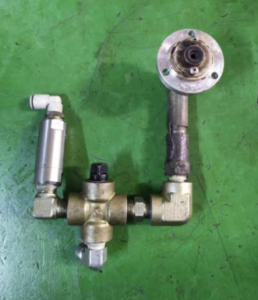
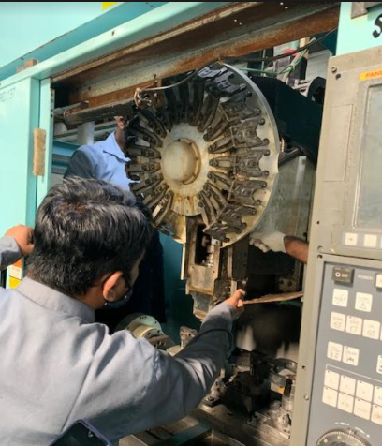
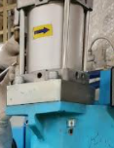



Steel Phase Laser marking machine Component Level Training
Laser Marking machine - Troubleshooting
Electrical Circuit of Laser marking machine
Understanding Error Codes and Interface
Understanding of laser marking process and its device connected
Knowledge of the required files and folders and their defined paths.
Understanding the Port systems and important spares
Check points
SrNo. | CHECK ITEM | CHECK CONTENTS | JUDGEMENT METHOD | STANDARD | CHECKING METHOD
1. | LASER UNIT MOUNING | LOOSE | CLEAN | CLEAN & TIGHT | TIGHTNED THE MOUTING WITH SPANNER
2. | MOTOR CABLES & CONNECTER | LOOSE & DAMAGED | TIGHT & NO DAMAGE | PULL THE CABLE & CHECK THE GLAND | BY HAND/ BY EYE
3. | PLC | MOUNTING LOOSE CONECTION LOOSE | TIGHT & NO DAMAGE | VISUAL | TIGHTNED THE MOUNTUNG WITH SCREW DRIVER
4 | FIXTURE CONDITION | LOOSE & DAMAGED | TIGHT & NO DAMAGE | BY HAND/ BY EYE | TIGHTNED THE MOUTING , PIN NOT DAMGE
5 | HMI | NOT WORKING | WORKING | VISUAL | BY EYE
M/c Standard Check points covered :
Equip. Std. Check Point | TBM Point | CBM Point | Total Points
 | 05 Nos. | 05 Nos. | 10 Nos

